Slide 1


Nexly : LLM-Powered Chatbot for Student Advising Computer Science Department College of Computing and Informatics
1
Zyead Alwsh
Theyab Mohammed
Niaz Mahmud
Abdullah Almazzmi
Supervisor:
Dr. Bouziane Brik

Slide 2
Outline
2
What is Nexly? - Why we built it? - How Nexly Works? - Similar Projects? - Nexly Mobile vs Nexly Web
How does Nexly Collect Data and Process it? - Data Collection and Processing.
Nexly’s RAG and Why it Matters? - RAG & Why?
Model Evaluation Methodology.
Nexly Mobile - Nexly Mobile System Overview. - Workflow and Component Architecture.
Nexly Web - Nexly Web Frontend Architecture. - Nexly Web Backend Architecture.
Conclusion - Future Directions for Nexly.

Slide 3
01
What’s Nexly ?
3

Slide 4
Nexly Nexly is an AI-powered academic assistant designed to support university students with academic advising and university-related queries. It uses Large Language Models (LLMs) and Retrieval-Augmented Generation (RAG) to provide real-time, personalized, and context-aware assistance across both mobile and web platforms. It aims to bridge the gap between fragmented university information systems and students' growing need for instant, accurate guidance.
4

Slide 5
Why We Built It ?
5
Nexly was built to solve major problems students face in universities today:
Fragmented information:
Students struggle to find clear, consistent answers across university systems.
Limited access to advisors:
High student-to-advisor ratios cause long wait times and rushed guidance.
Static, outdated support tools:
FAQ pages and basic chatbots don't offer personalized, real-time help.

Slide 6
How Nexly Works ?
6
(a) Web Approach
Utilizes Llama 3.3 with a custom-built RAG pipeline and custom vector store for accurate answers.
(b) Mobile Approach
Runs on Gemini 2.0 Flash + Exa.ai for semantic search and fast response generation.
Each platform is tailored for optimal performance—responsiveness on mobile, accuracy on web, It Transforms vague queries into structured prompts through contextual optimization.

Slide 7
Similar Projects to Nexly
7
(a) AISHA – ZU, UAE
Uses OpenAI models with strong multi-source retrieval and tool integration.
(b) UAEU Bot – UAE University
Functional bot with voice/text UI, yet very limited conversational depth due to predefined structure.
(b) Cal Student Chatbot – UC Berkeley
Rule-based system focused on admin queries but lacks adaptability to nuanced needs.
(d) BARKPLUG V.2 – MSU
Employs RAG and vector search, similar to Nexly’s web architecture.

Slide 8
Nexly Mobile vs Nexly Web
8
 | Nexly Mobile | Nexly Web
Retrieval Method | Uses Exa.ai for live web semantic search | Uses RAG pipeline with local documents
Model | Google Gemini 2.0 Flash for fast mobile responses | LLaMA 3.3 for deeper, grounded responses
Data Source | Real-time search across university websites | Preprocessed university PDFs, webpages
Architecture Goal | Low-latency, quick, on-the-go answers | Highly accurate, document-backed answers
Device Focus | Smartphones (Flutter app) | Browsers (React.js web app)
Notes:
from desktops to pockets.

Slide 9
02
How does Nexly Collect Data and Process it?
9

Slide 10
Data Collection and Processing
10
How was Nexly’s Data Extracted?
Webpages and PDFs were collected from UOS website.
Selenium was used to crawl and save all links into a .txt file.
HTML content was extracted from webpages and cleaned of scripts and styles
LlamaIndex processed PDFs into structured .txt files labeled with metadata.
How was Nexly’s Data Processed?
Text was split into 250-word chunks to fit within LLM input limits.
Each Chunk was converted into a 786-dimensional vector using the multi-qa-mpnet-base-dot-v1 model.
The vectors were saved in a CSV and planned to move to a vector database like FAISS later
When a question is asked, Nexly finds the most semantically similar chunks based on cosine similarity.
Nexly verifies the quality of the response before presenting it.

Slide 11
03
Nexly’s RAG and Why It Matters ?
11

Slide 12
RAG & Why?
12
Prevent Hallucination → RAG grounds outputs in retrieved documents, reducing misinformation from LLM hallucinations.
Domain-Specific Accuracy → Incorporates institutional content (e.g., UoS) to improve contextual correctness.
Adaptive Responses → Dynamically retrieves relevant content before answering—ensuring contextual precision.
Traceability → Allows citation of source documents, adding transparency and user trust.

Slide 13
04
Model Evaluation Methodology
13

Slide 14
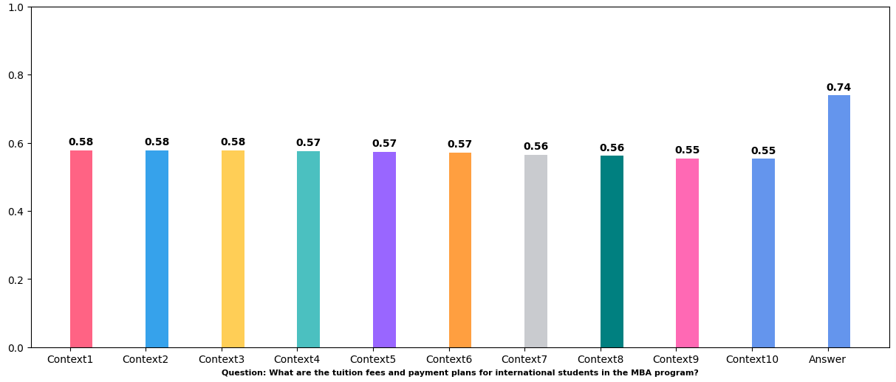
Query: “MBA Program Tuition and payment Plans”
14
Approach:
Retrieved relevant context chunks using cosine similarity.
Generated an answer using the RAG pipeline.
Evaluated semantic similarity between: - Query vs. Retrieved Contexts - Query vs. Final Generated Answer
Results:
Context similarity: ~0.55–0.58
Final answer similarity: 0.74
27.6% relevance boost after processing, demonstrating improved answer quality.

Slide 15
05
Nexly Mobile
15

Slide 16
Nexly Mobile System Overview
16
 | Technology | Purpose
Frontend | Flutter (Dart) | UI, state management, device integration
State | Riverpod | Reactive state and dependency injection
Storage | SharedPreferences | Saving user settings, threads, messages
AI Backend | Google Gemini + Exa.ai | Query optimization and university-specific search
Analytics | Dart Logging | Performance tracking and debugging
CI/CD | GitHub Actions | Automating build, test, and deploy

Slide 17
Workflow and Component Architecture
17
User inputs query into Flutter app
Query Optimization: - Google Gemini refines query for better search results
Semantic Search: - Exa.ai searches UOS-specific websites for 8 best documents.
Contextual Response Generation: - Gemini generates a Markdown-formatted answer using retrieved documents + past 10 messages.
Display and storage: - Response is displayed in the chat interface - Messages stored locally with SharedPreferences for offline access.

Slide 18
06
Nexly Web
18

Slide 19
Nexly Web Frontend Architecture
19
 | Technology | Purpose
Framework | React.js | Modular, component-based UI
Styling | Pure CSS + CSS Variables | Responsive theming (light/dark mode)
State Handling | useState, useEffect hooks | Manage inputs, theme toggle, resizing
UI Features | Chat interface (user/AI threads) Animated Typing indicators Responsive Design

Slide 20
Nexly Web Backend Architecture
20
 | Technology | Purpose
Model API | Custom LLAMA-3.3 70B (RAG) | Local server (planned cloud hosting)
Communication | Axios (HTTP requests) | Sending/receiving user queries and AI answers
API Endpoint | Local/Private IP (http://192.168.x.x:8709/askQuestion/) | Planned migration to authenticated hosted server
Backend Model | FastAPI with RAG pipeline | Embedding search + RAG answer generation
Future Plan | Add database (user settings, chat history), integrate Gemini/Exa.ai​

Slide 21
07
Conclusion
21

Slide 22
Conclusion
22
- Nexly demonstrates that AI can transform academic advising by making it personalized, scalable, and accessible.
Developed two fully working MVPs:
➔ Mobile App (fast, responsive)
➔ Web Platform (accurate, document-grounded)
- Combines Large Language Models (LLMs) and Retrieval-Augmented Generation (RAG) to deliver real-time, context-aware support.
- Bridges the gap between complex university systems and students' needs.
- Designed with ethical AI practices, transparency, and user-centered design.
- Future-ready for deeper integrations like SSO, API access, voice input, and localization.

Slide 23
Future Directions for Nexly (App + Web)
23
Data and Personalization - Integrate with University of Sharjah Single Sign-On (SSO) for secure, personalized student data. - Fine-tune an LLM on UOS-specific academic content.
System Upgrades - Move embeddings to a vector database (like FAISS or Weaviate) for sub-100ms retrieval even at millions of records. - Implement Corrective RAG.
Mobile App Enhancements - Bring full RAG pipeline to mobile. - Add push notifications, speech-to-text input, Arabic/English localization, and offline caching.
Web App Improvements - Implement user authentication, saved chat history, file uploads for custom questions, and LMS (Blackboard) integrations. - Add browser-based caching for offline access.

Slide 24
Thank you for your time!
24

